Slide 1
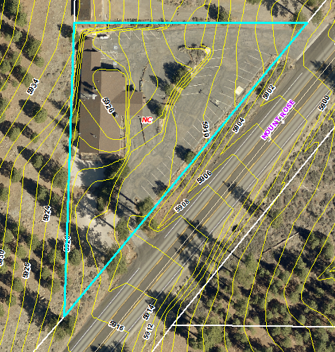
Administrative Permit WADMIN18-0009
Washoe County
Board of Adjustment
August 2, 2018
Lodge at Galena

Slide 2
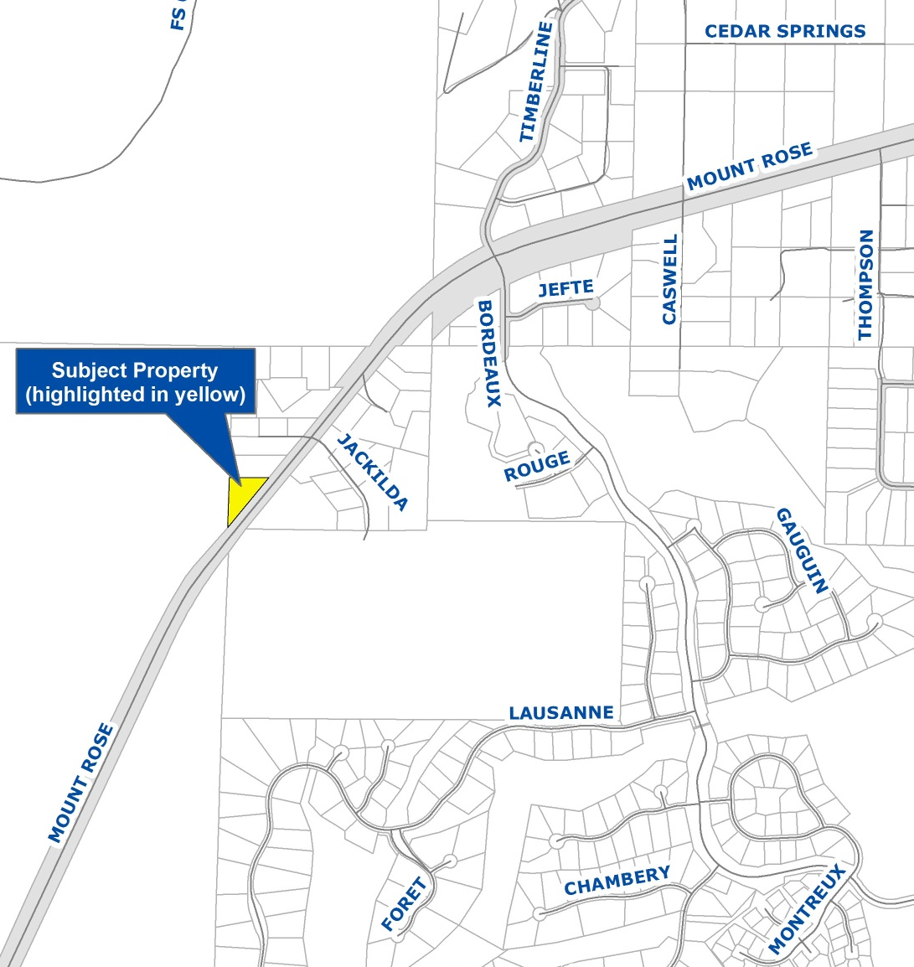
Vicinity Map
17025 Mt. Rose Highway
½ mile southwest of Timberline Drive
Previously the Lodge at Galena
Neighborhood Commercial
.99-acres
Within Mt. Rose Scenic Highway Commercial Overlay District

Slide 3
Overview of Request
Three tenants on-site
First tenant (doctor’s office) allowed by right
Two uses require Admin Permit in NC:
  Snowind Sports – Retail Sales – Specialty Stores use type
  Wine/coffee bar – Liquor Sales – On-Premises use type

Slide 4
Overview of Request
Located within existing re-modeled structure
Snowind Sports: ±1,700 sq. ft.
Wine/coffee bar: ± 800 sq. ft.; ± 740 sq. ft. outdoor uncovered concrete patio

Slide 5
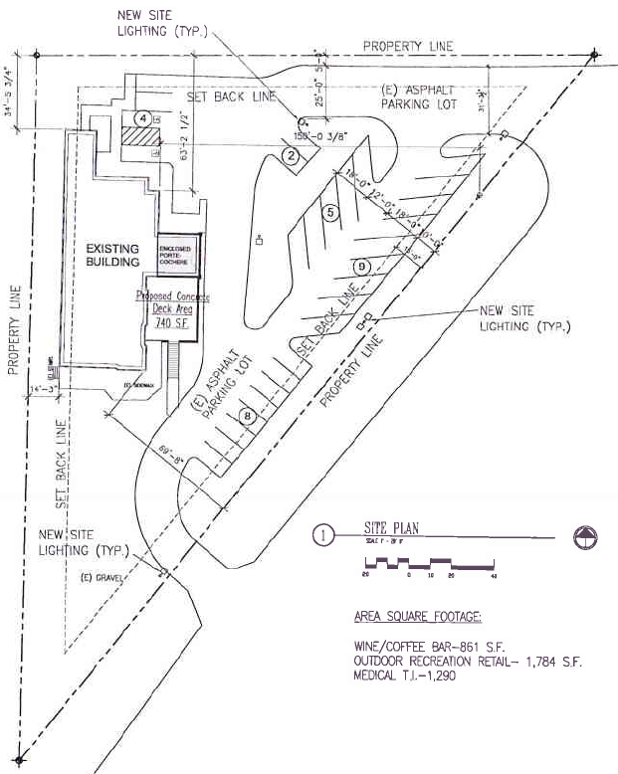
Site Plan
MT. ROSE HWY
MT. ROSE HIGHWAY

Slide 6
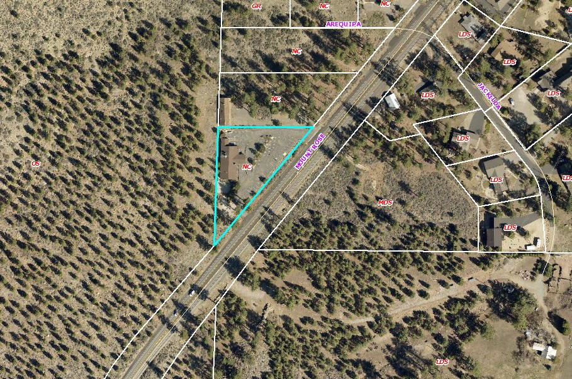
Aerial Photo

Slide 7
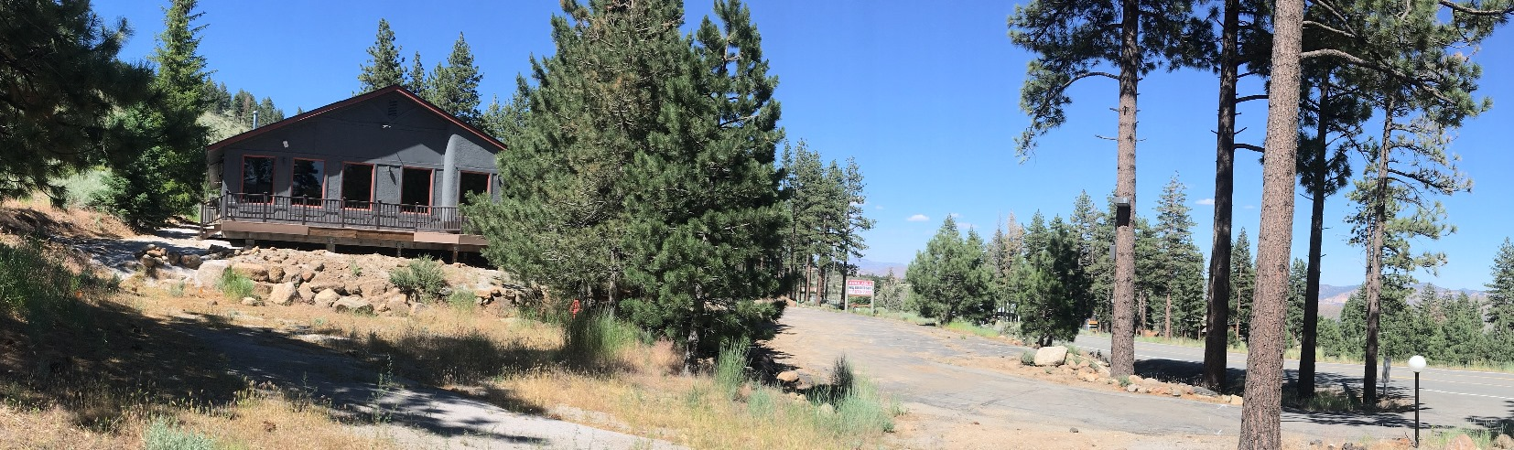
Site Photo

Slide 8
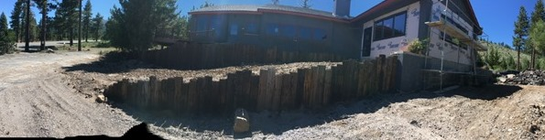
Site Photo

Slide 9
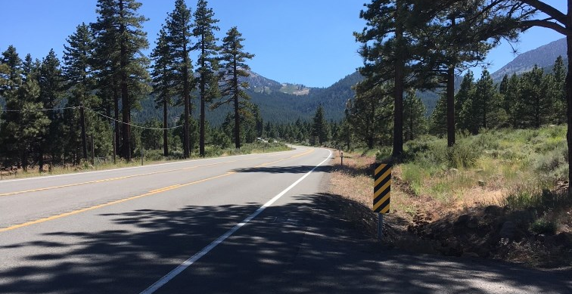
Site Photo

Slide 10
Project Details
Hours: 7 a.m. – 7 p.m. weekdays; 7 a.m. – 8 p.m. weekends
Access: 2 existing driveways off Mt. Rose Hwy; center turn lane exists
Traffic: Generate 35 a.m. peak hour and 30 p.m. peak hour trips
Standards for parking, landscaping, lighting, noise must be met
Mt. Rose Scenic Roadway Corridor Standards

Slide 11
Citizen Advisory Board (CAB)
July 5: South Truckee Meadows/Washoe Valley CAB
Questions on hours, lighting, and previous liquor licenses
Two spoke in favor of request
CAB voted unanimously to recommend approval

Slide 12
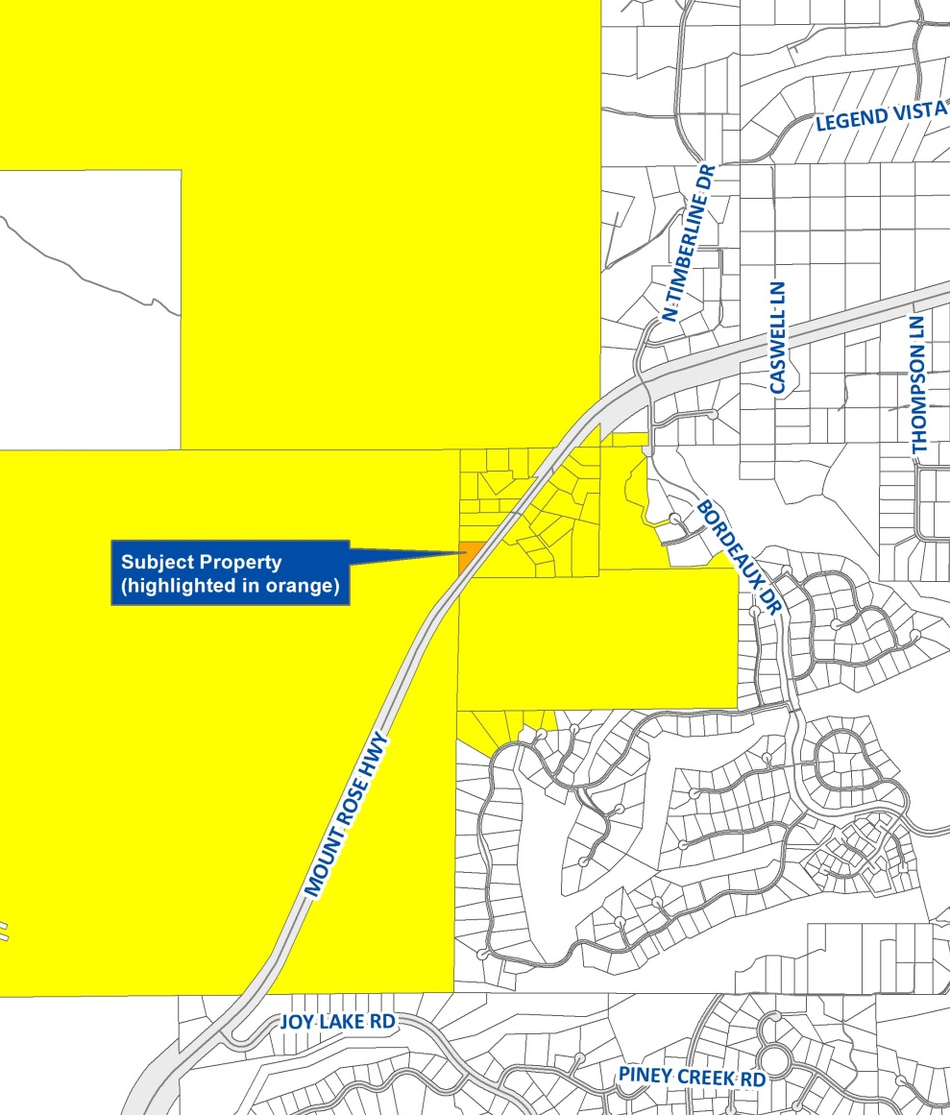
Public Notice
Notice provided to 35 owners of 44 parcels within 1,500-ft.

Slide 13
Reviewing Agencies
Washoe County Community Services Department
  Planning and Building
  Engineering and Capital Projects
  Utilities/Water Rights
Truckee Meadows Fire Protection District
Washoe County Health District
Regional Transportation Commission
Nevada Department of Transportation
Nevada Division of Water Resources
Truckee Meadows Water Authority
U.S. Forest Service
Washoe-Storey Conservation District

Slide 14
Recommended Conditions
Standard conditions for lighting, landscaping, parking, screening
Mt. Rose Scenic Roadway Corridor standards
Compliance with Forest Area Plan policies
Operational conditions, incl. hours
Building codes
Water usage & public water system
One-way driveway circulation (NDOT addendum)

Slide 15
Required Findings
Consistency
Improvements
Site Suitability
Issuance not Detrimental
F.2.13 Forest Area Plan community character
Recommendation: Approval with conditions

Slide 16
Possible Motion
I move that, after giving reasoned consideration to the information contained in the staff report and received during the public hearing, the Board of Adjustment approve, with conditions, Administrative Permit Case Number WADMIN18-0009 for Burkhart Management Group, for both of the proposed uses, having made all four findings in accordance with Washoe County Code Section 110.808.25, and the additional finding required by the Forest Area Plan. This approval includes additional conditions 5 (a) through (l), as provided with the staff report addendum.

